Slide 1
Text Editor Tricks for Blue Teamers
https://github.com/theaj42/presentations
@ajvanbeest

Slide 2
whoami

Slide 3
Soggy, dirty, cold, hot, tired

Slide 4


Slide 5
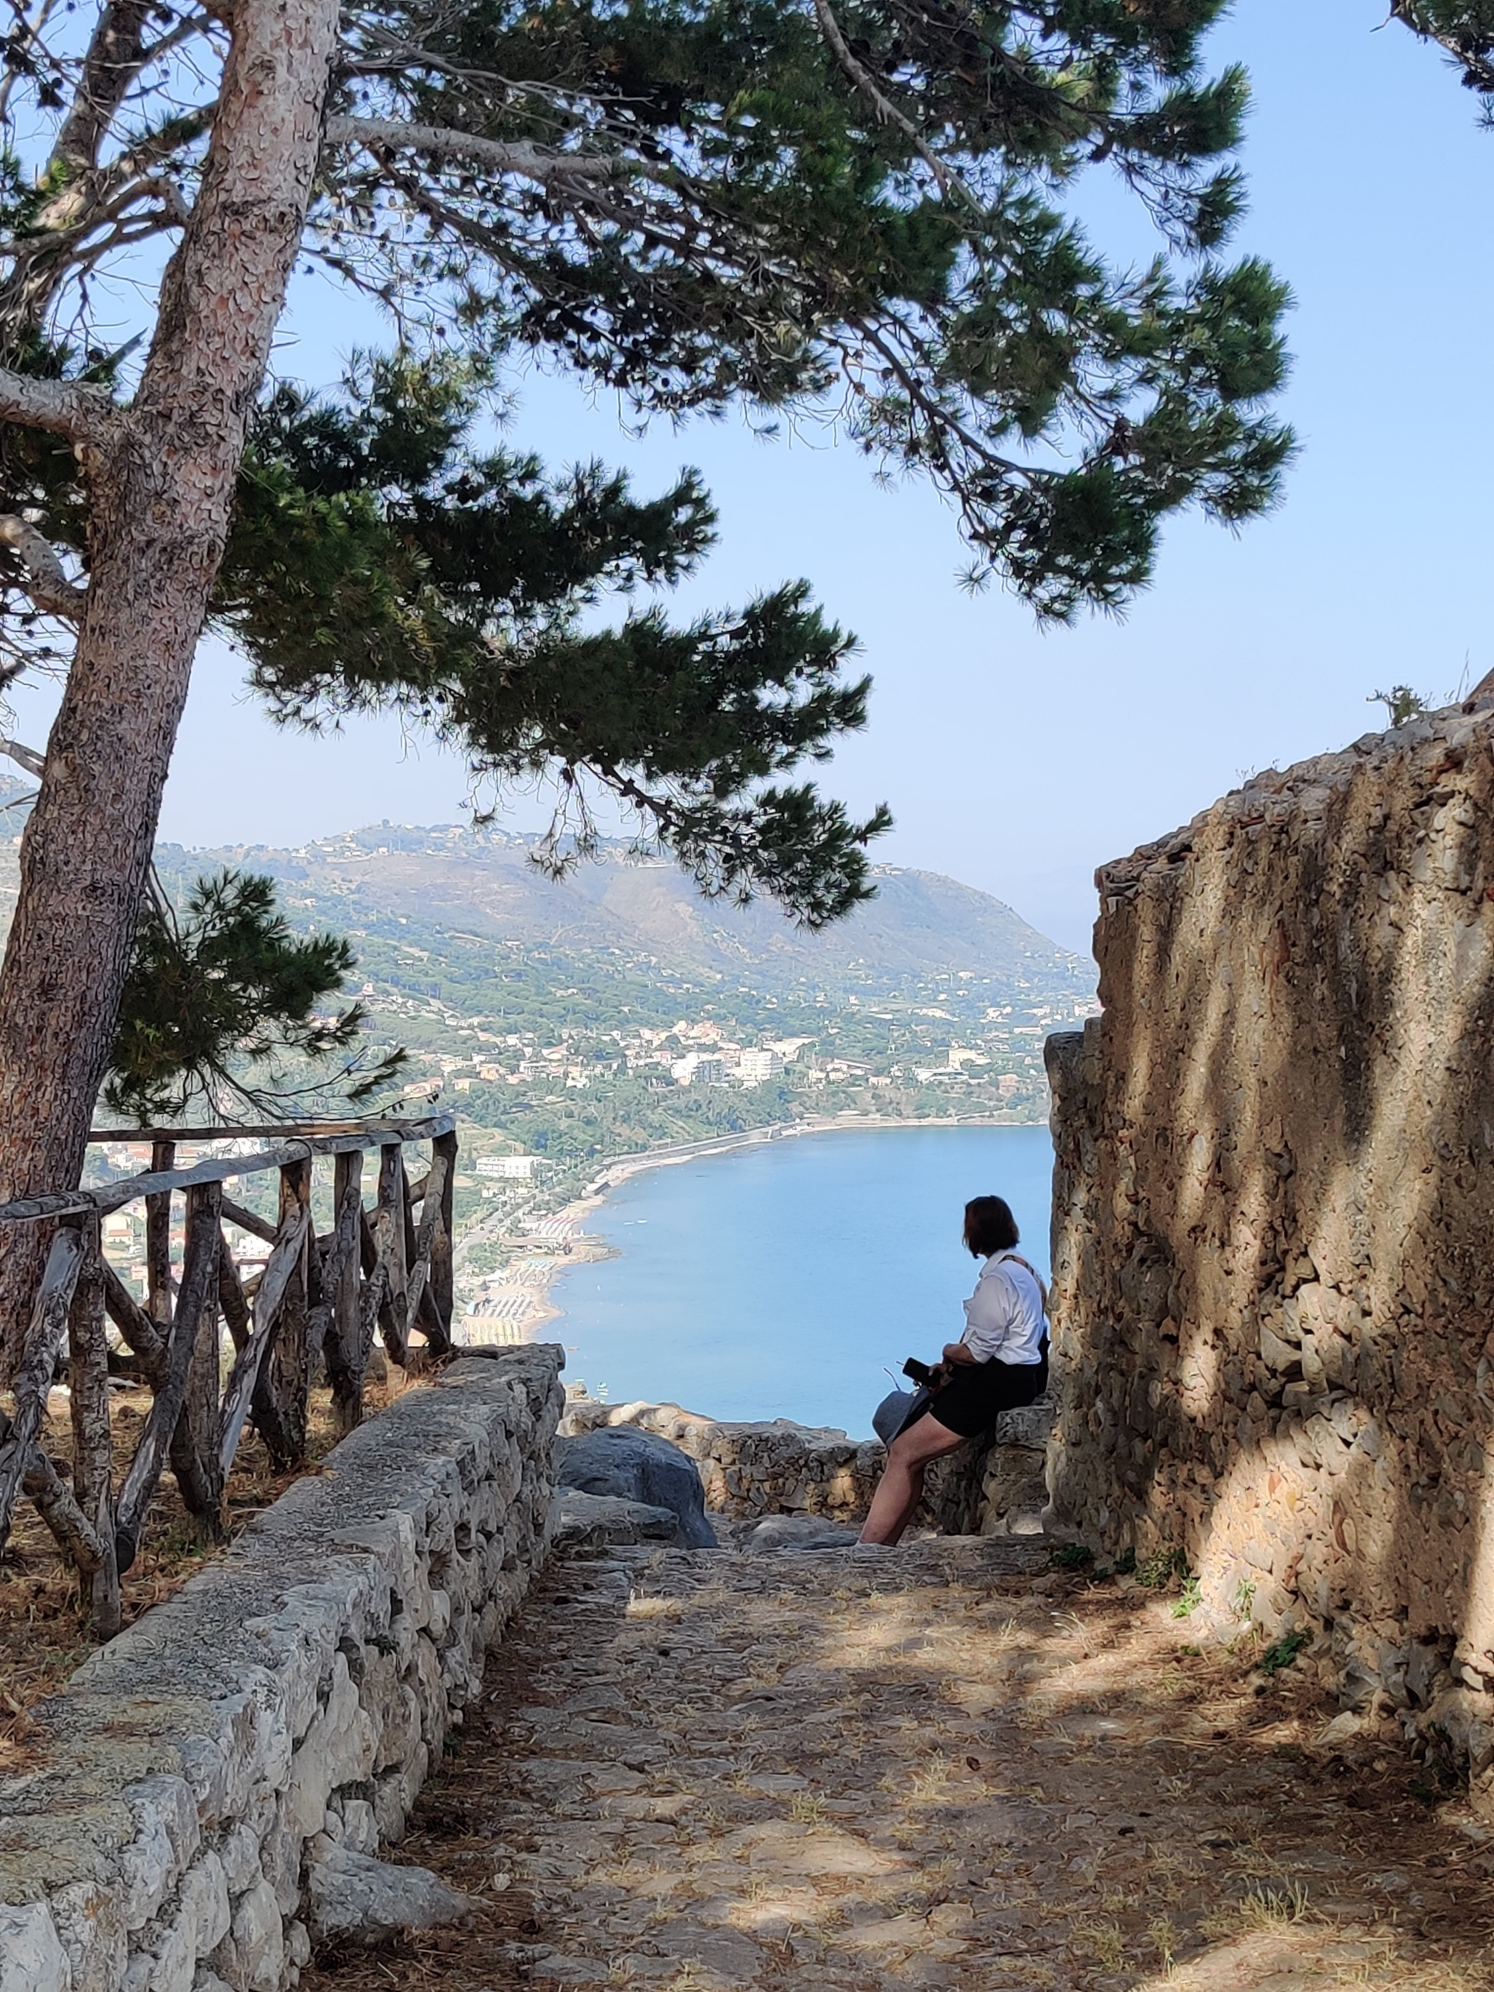

Slide 6


Slide 7
Neurodivergent

Slide 8
Data nerd

Slide 9
Hacker-lazy

Slide 10
TOC

Slide 11
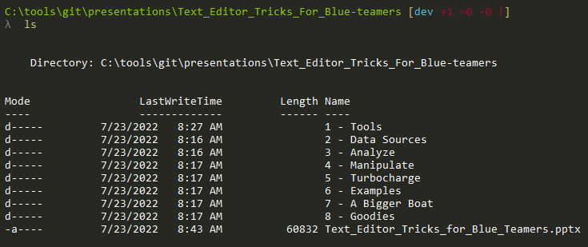

Slide 12
..\TextEditor\Tools

Slide 13


Slide 14
Built for comfort

Slide 15


Slide 16
Built for speed

Slide 17


Slide 18
..\TextEditor\Data

Slide 19
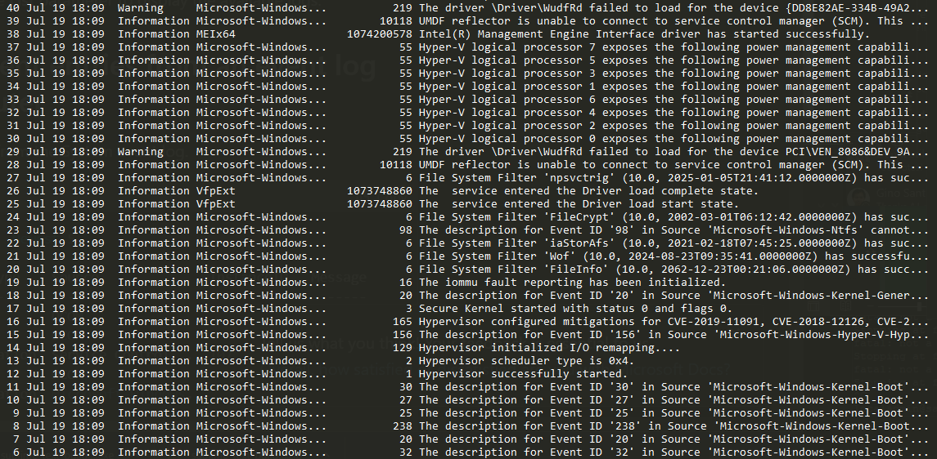
Log files

Slide 20
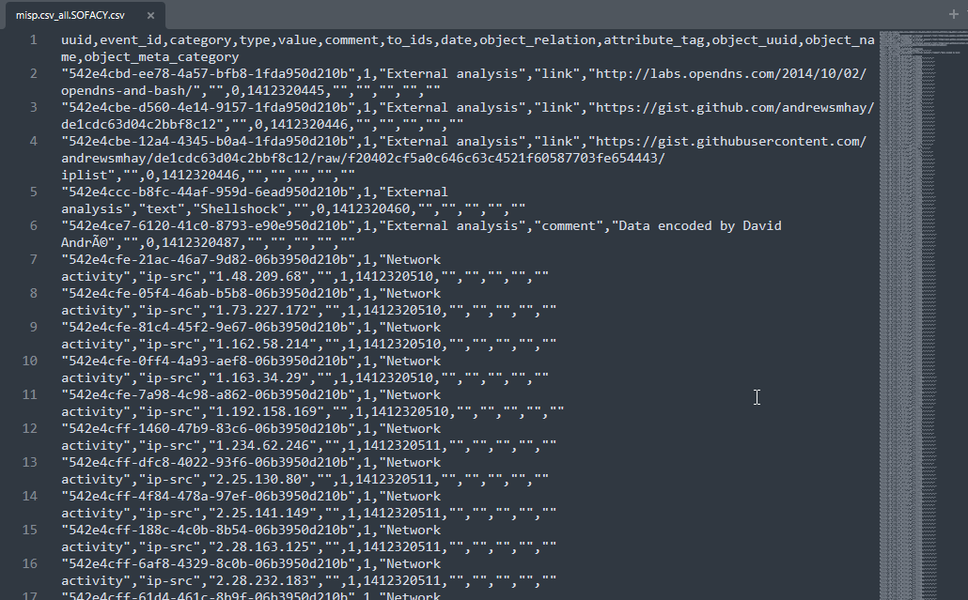
Observables / IOCs

Slide 21
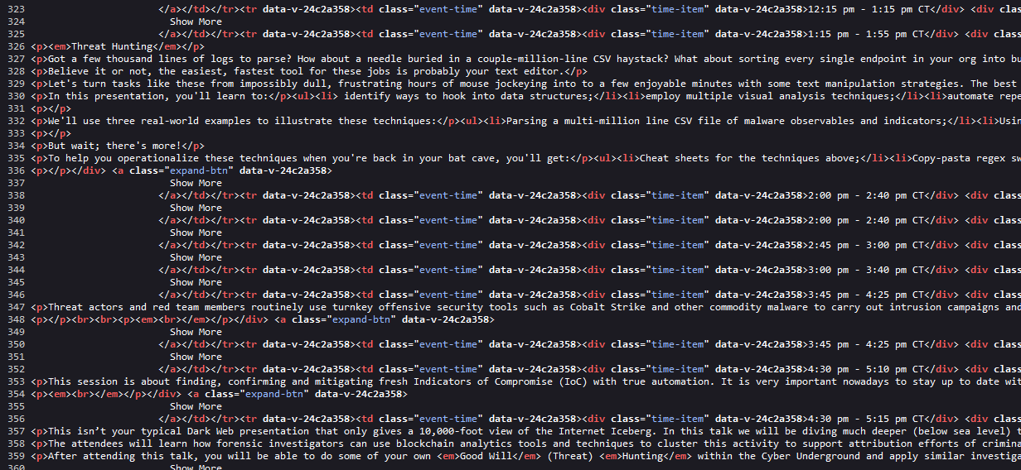
Web data

Slide 22
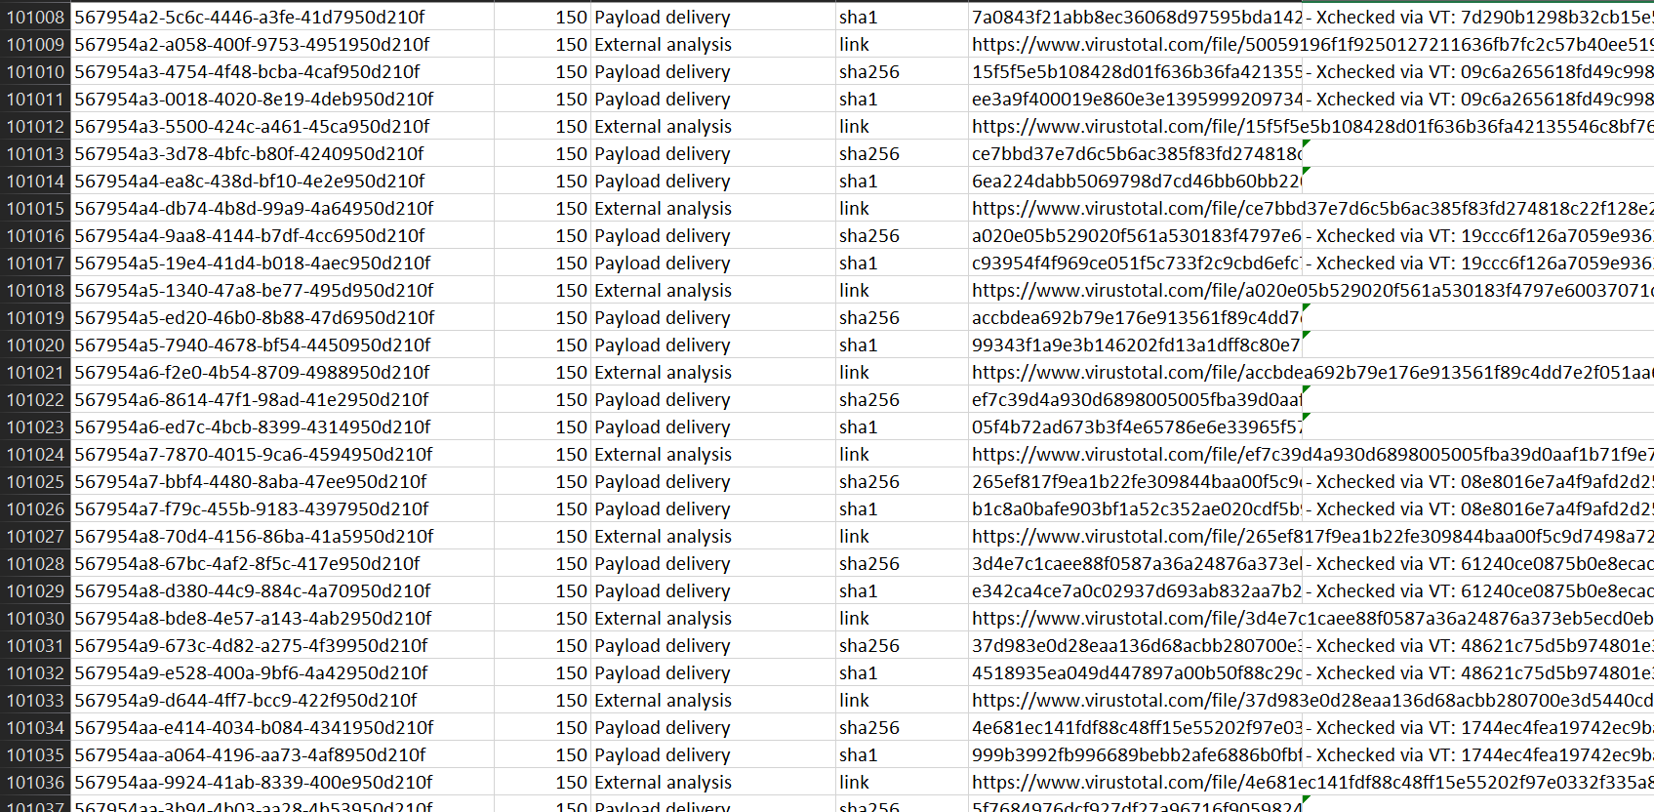
Delimited data

Slide 23
Needs to be text (obvs)

Slide 24
..\TextEditor\Analysis

Slide 25
“Visual Analysis”

Slide 26
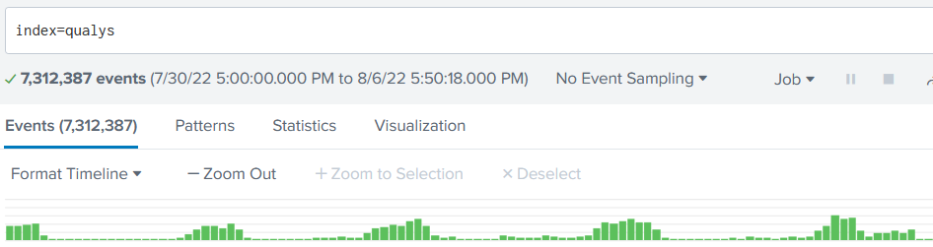
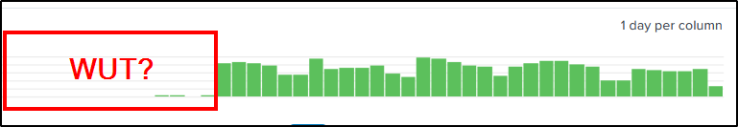

Slide 27
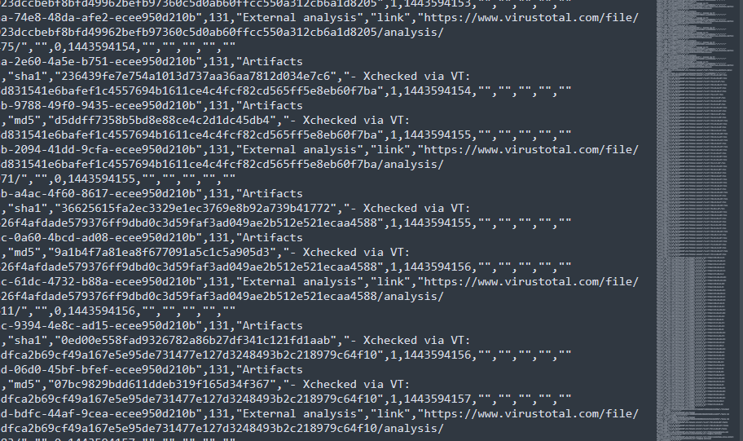

Slide 28
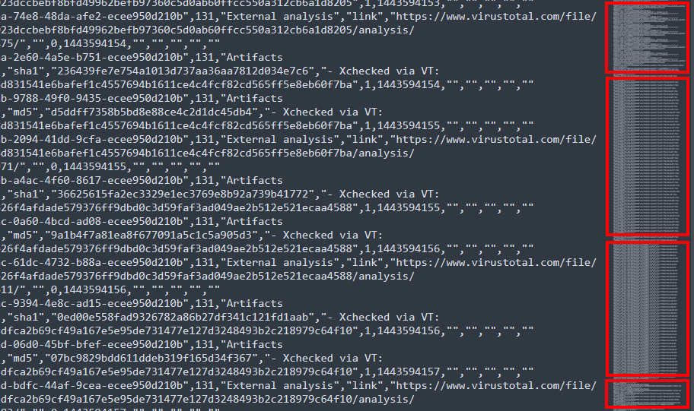

Slide 29
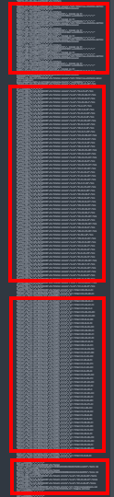
Hashes checked via VT
Destination IPs
URLs
Payload hashes

Slide 30
Pattern Analysis

Slide 31
Sorting reveals patterns

Slide 32
Patterns point to data

Slide 33
Data becomes information

Slide 34


Slide 35
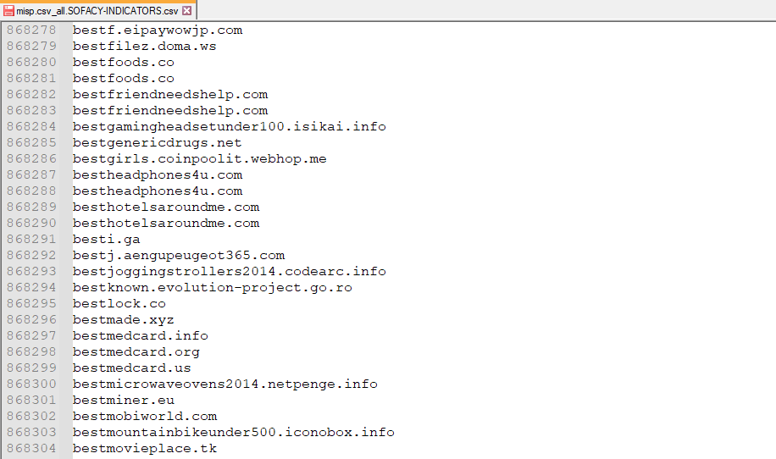

Slide 36
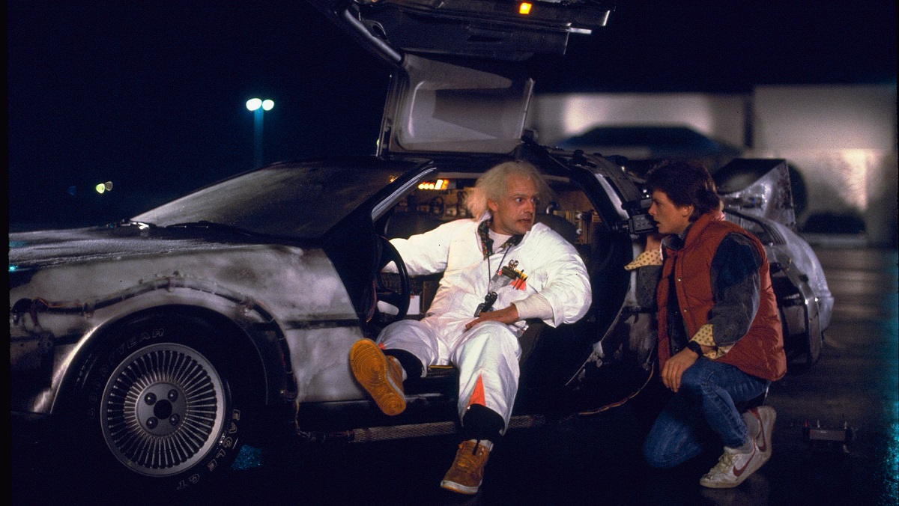

Slide 37
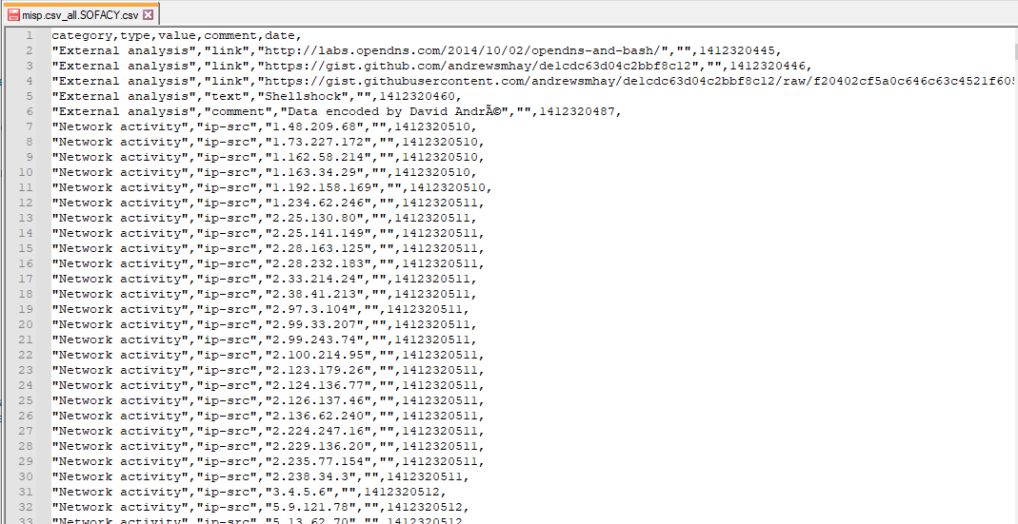

Slide 38


Slide 39
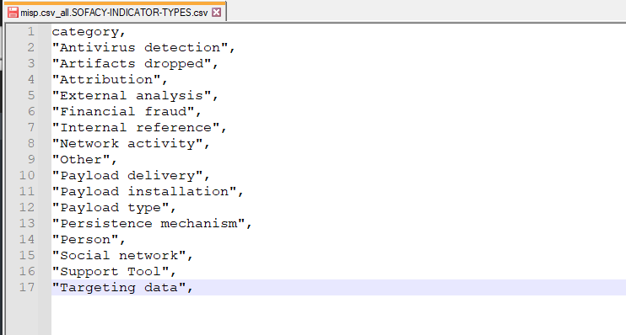

Slide 40


Slide 41
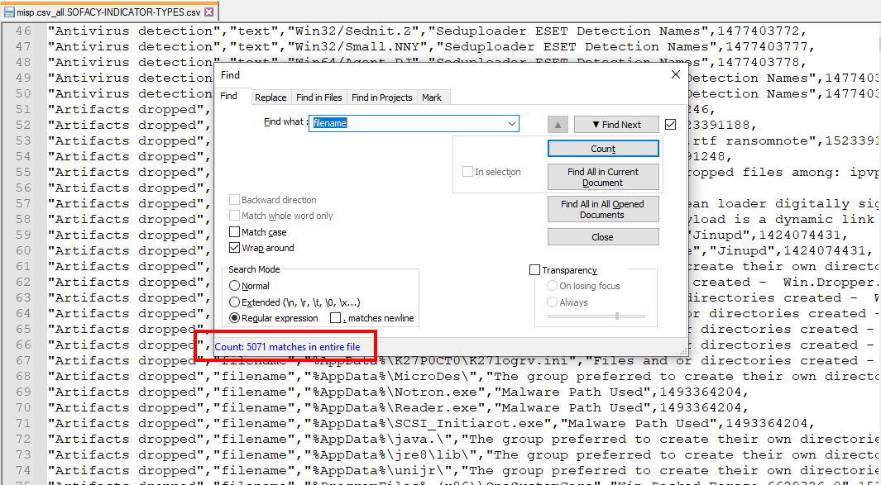

Slide 42
..\TextEditor\Turbo

Slide 43
Amplification!

Slide 44
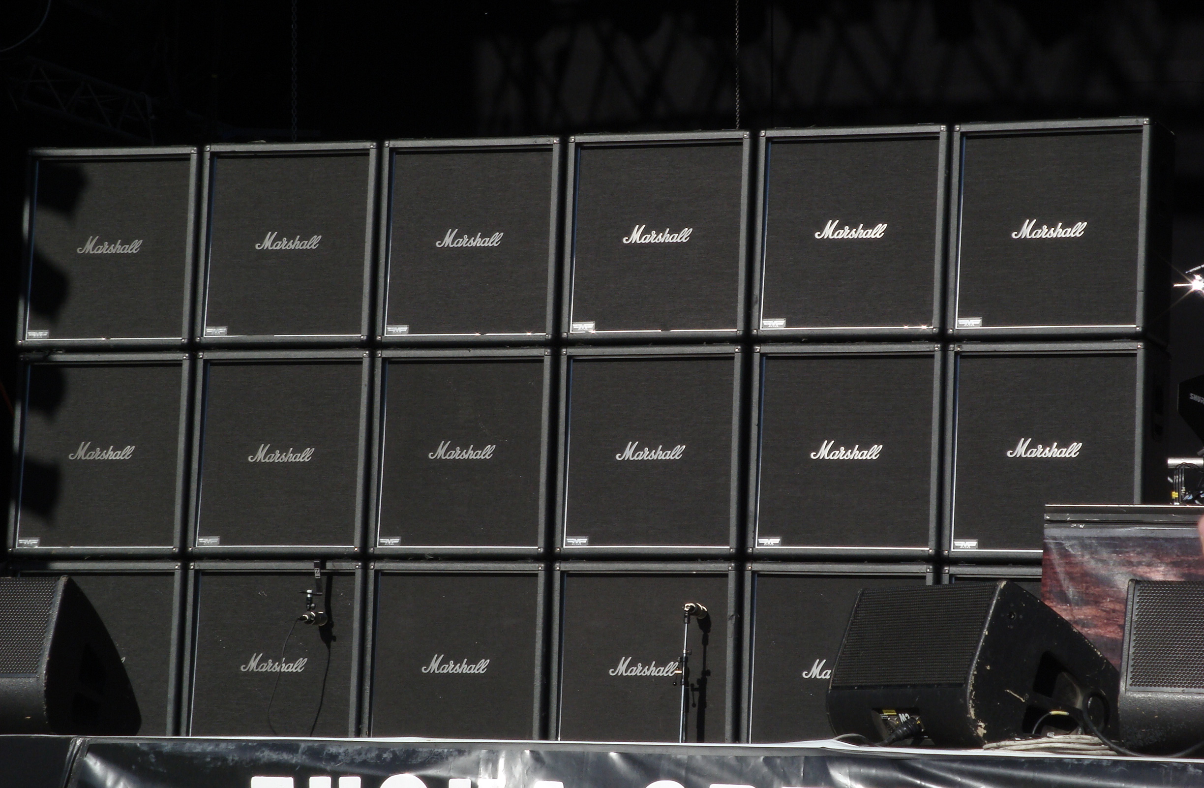

Slide 45
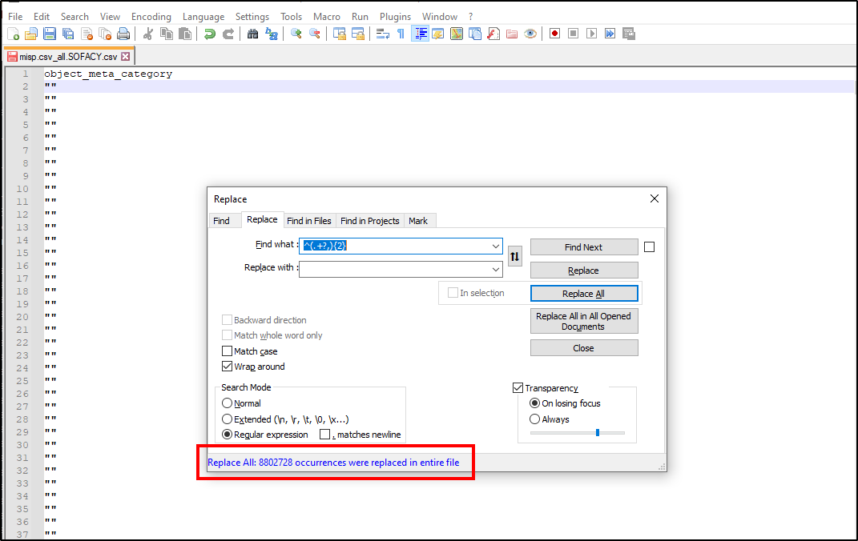

Slide 46


Slide 47
Deduplication

Slide 48
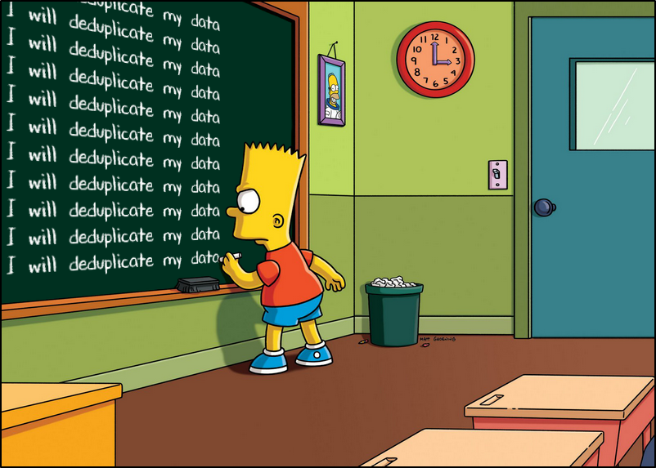

Slide 49
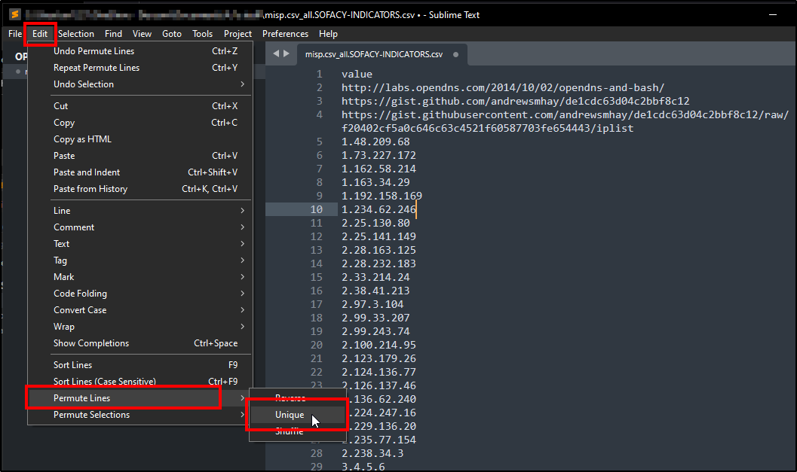

Slide 50
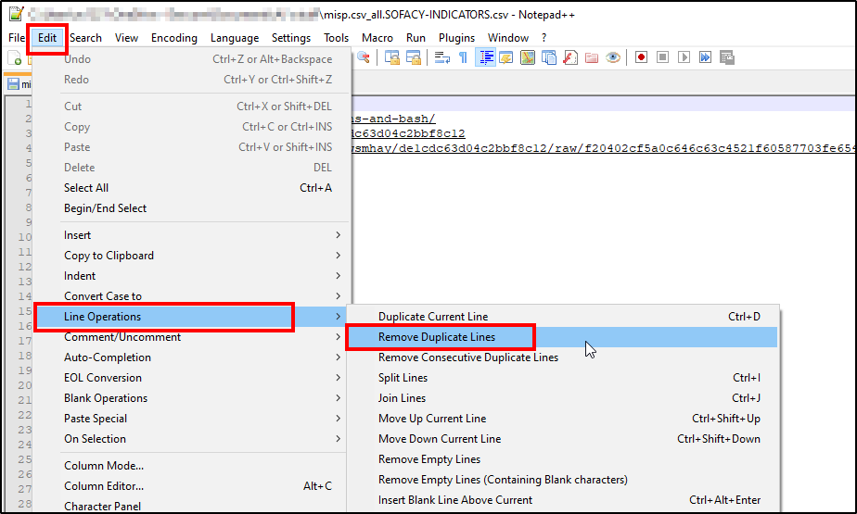

Slide 51
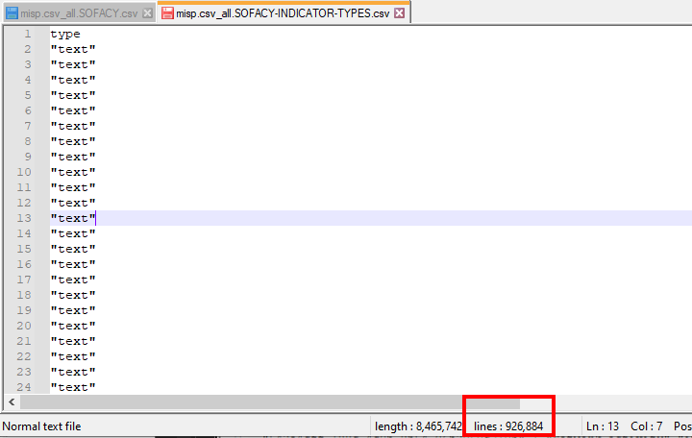

Slide 52
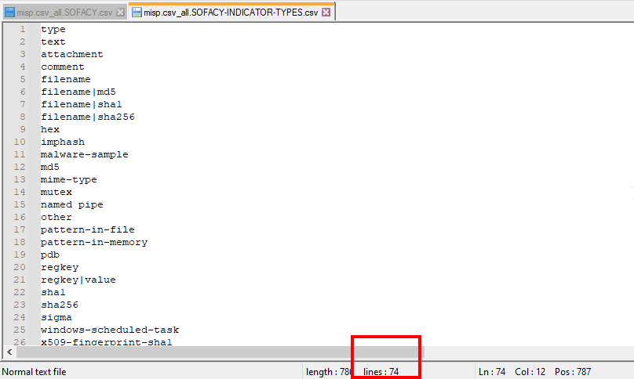

Slide 53
Diff (two or more)

Slide 54
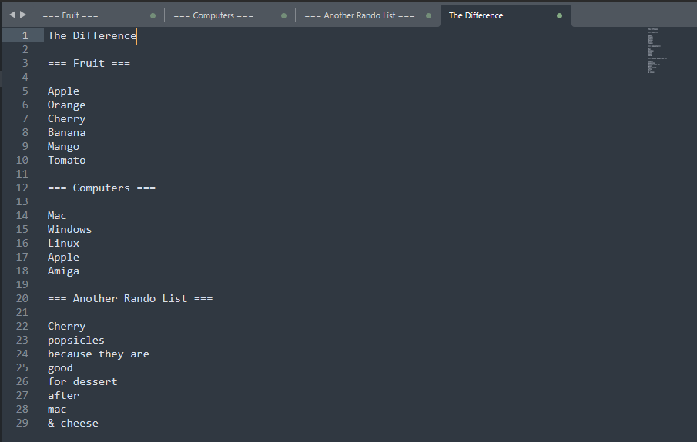

Slide 55
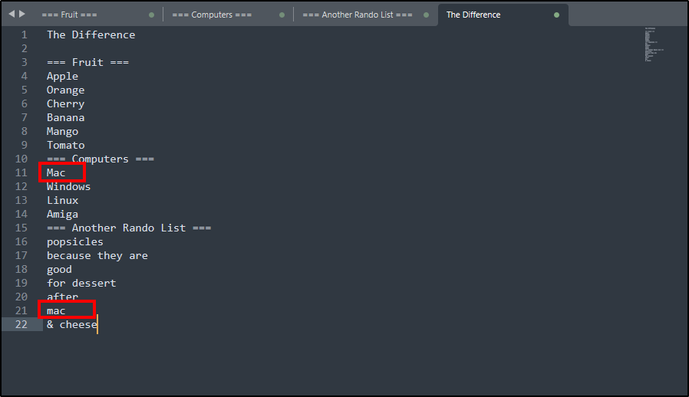

Slide 56
Regex <happy_sigh/>

Slide 57
Find text patterns

Slide 58
^(?:.+?,){2}(.+?,)(.+?,)(.+?,)(?:.+?,){2}(.+?,)(?:.+?,){3}(.+?),(?:.+?$)

Slide 59
^(?:.+?,){2}(.+?,)(.+?,)(.+?,)(?:.+?,){2}(.+?,)(?:.+?,){3}(.+?),(?:.+?$)

Slide 60
uuid,event_id,category,type,value,comment,to_ids,date,object_relation, attribute_tag,object_uuid,object_name,object_meta_category

Slide 61
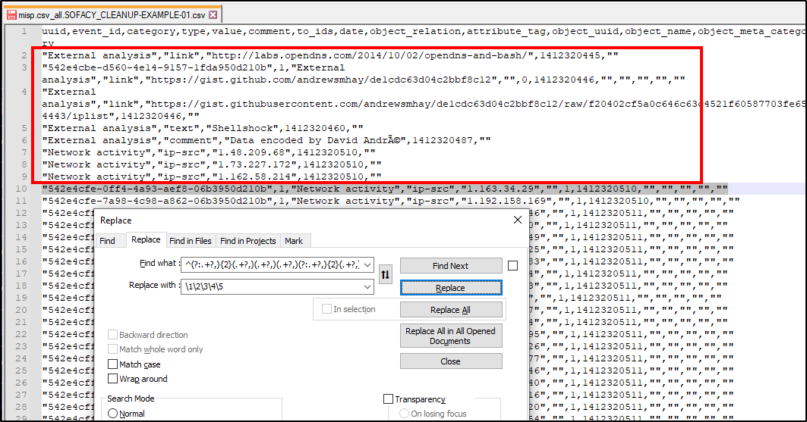

Slide 62
Scriptable patterns

Slide 63


Slide 64
find | update | tag | transform

Slide 65
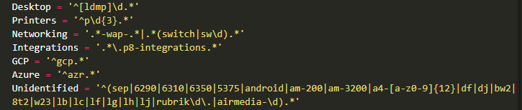
$RegEx = @{
}

Slide 66
..\TextEditor\Examples

Slide 67
A “biggish” CSV

Slide 68
“Denoizification”

Slide 69
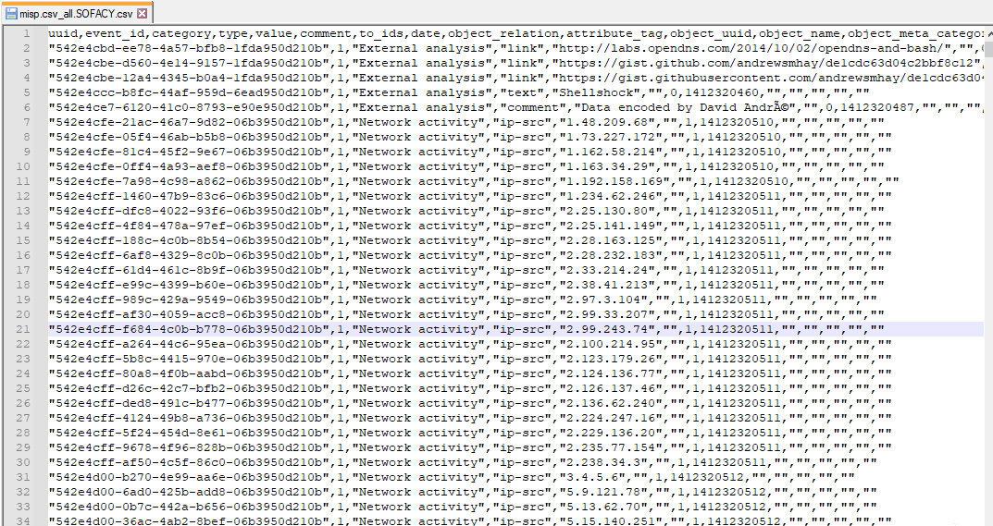

Slide 71
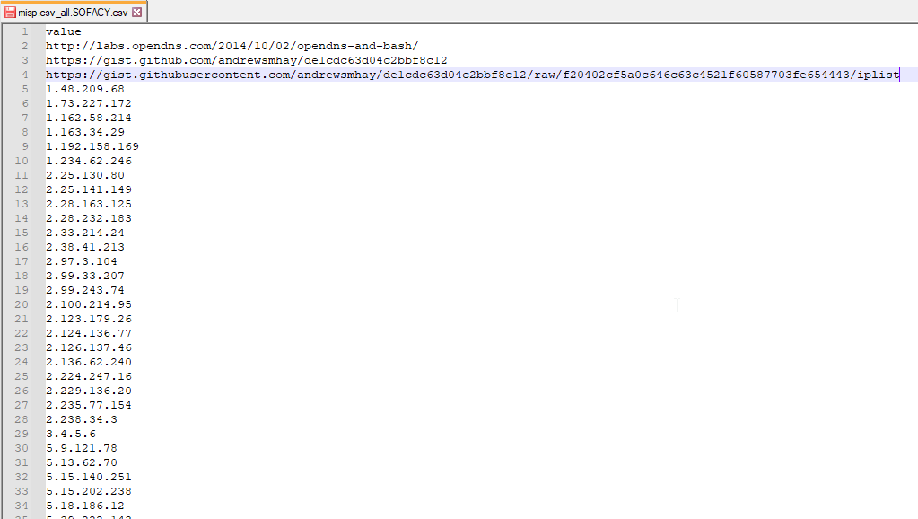

Slide 72
Birds of a Feather

Slide 74
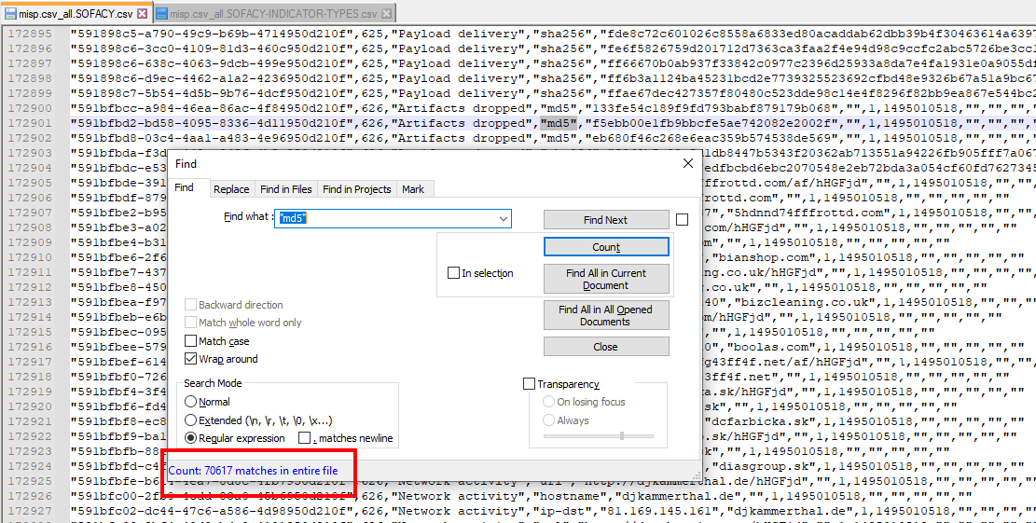

Slide 75
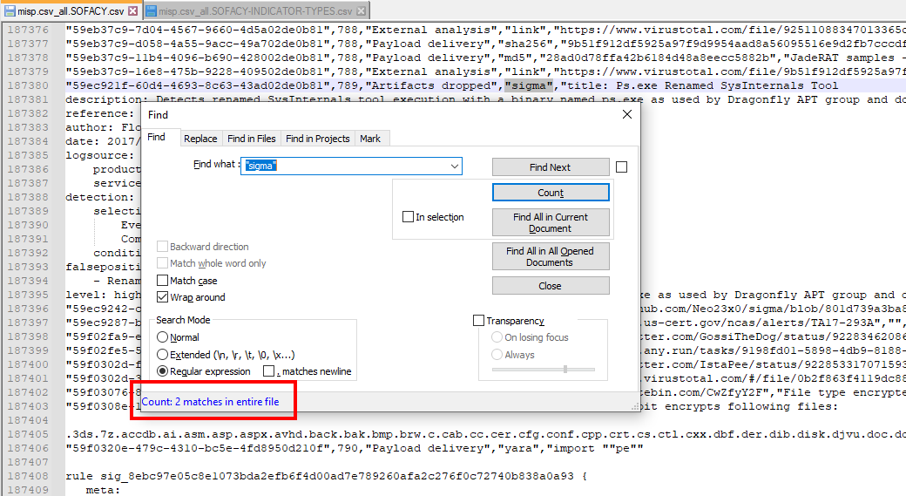

Slide 76
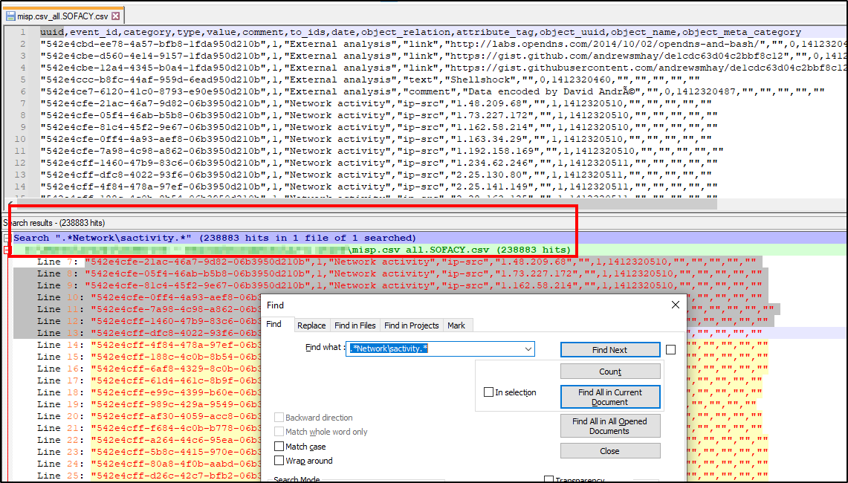

Slide 77
The case of the lazy vendor

Slide 78
“Hey, we saw some things!”

Slide 79
URL 1 URL 2 URL 3 URL n

Slide 80
“We may have repeated ourselves.”

Slide 81
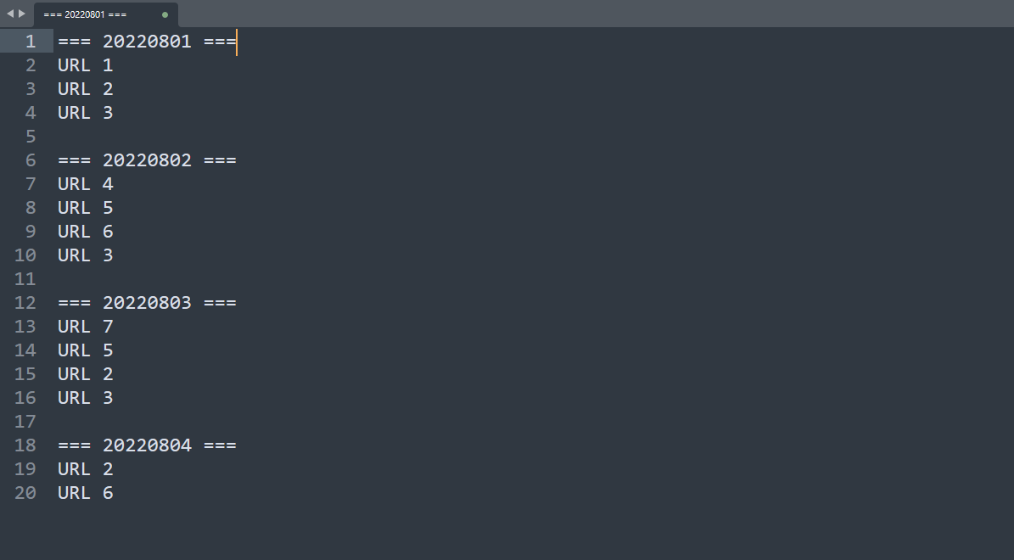

Slide 82
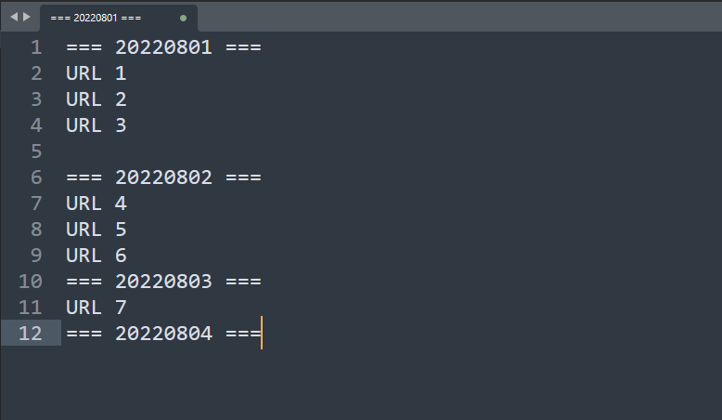

Slide 83
Super-duper-cedence

Slide 84
“Oh, we can’t patch that.”

Slide 85


Slide 86
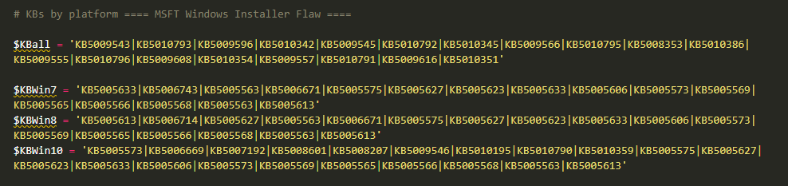

Slide 87
..\TextEditor\A Bigger Boat

Slide 88


Slide 89
Filtering

Slide 90
Data visualization

Slide 91
Pivoting

Slide 92
..\TextEditor\Goodies

Slide 93
Technique guides… Regex cheat sheet… Example files… This fabulous deck!

Slide 94
https://github.com/theaj42/presentations

Slide 95
kthxbye

